Slide 1
Recommendation System
Arnab Dana
Department of Computer Science and Engineering
National Institute of Technology
Uttarakhand, India

Slide 2


Slide 3
Table Of Contents
Introduction
Types of Recommendation
Content-Based Filtering
Collaborative Filtering
Hybrid Recommendation
Use Cases and Applications
Benefits of Recommendation Systems
Recommendation Technology

Slide 4
Introduction
A recommendation system (or recommender system) is a class of machine learning that uses data to help predict, narrow down, and find what people are looking for among an exponentially growing number of options.
A recommendation system is an artificial intelligence or AI algorithm, usually associated with machine learning, that uses Big Data to suggest or recommend additional products to consumers. These can be based on various criteria, including past purchases, search history, demographic information, and other factors. Recommender systems are great for helping users discover new products and services they might not have found otherwise.

Slide 5
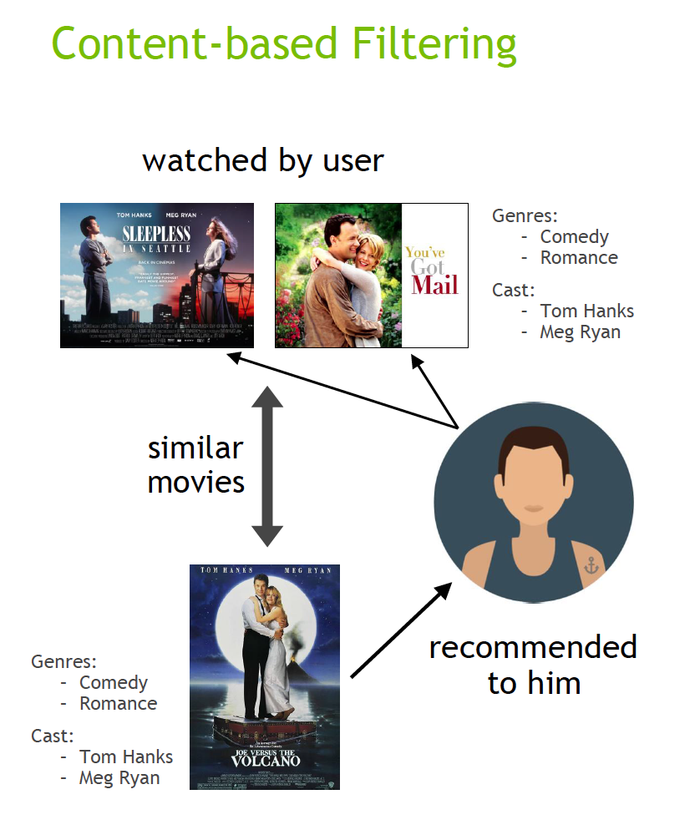
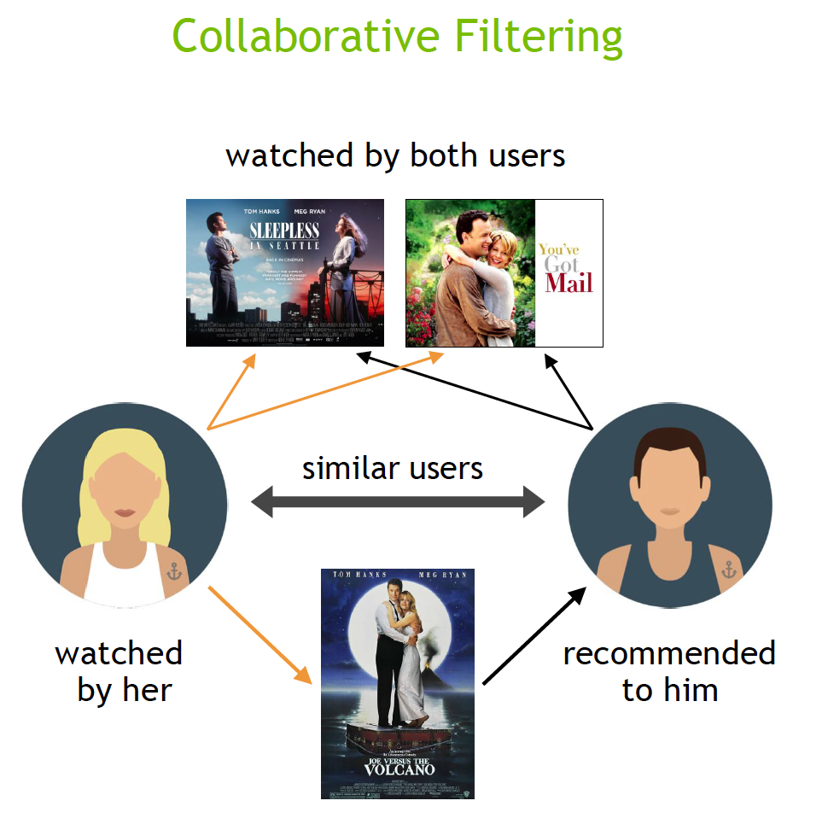
Types of Recommendation

Slide 6
Types of Recommendation
Content-Based Filtering: Recommends items based on their attributes and features, matching user preferences with item characteristics.
Collaborative Filtering: Analyzes user behavior and preferences to recommend items based on similarities between users.
Hybrid Recommendation: Content-Based Filtering + Collaborative Filtering
Context filtering: Context filtering Predicts user actions based on contextual information like country, device, date, and time, enhancing recommendations in platforms like Netflix.

Slide 7
Use Cases and Applications
E-commerce Product Recommendations
Movie and TV Show Recommendations
Music Recommendations
News and Content Recommendations
Social Media Friend Recommendations
Travel Recommendations
Job and Career Recommendations
Health and Fitness Recommendations
Education and Learning Recommendations
Real Estate Recommendations

Slide 8
Benefits of Recommendation Systems
Personalized User Experiences
Revenue Generation
Retention Improvement
Sales Boost
Habit Formation
Time Efficiency
Cart Value Enhancement

Slide 9
Types Of User Feedback
Implicit feedback: This is indirect feedback that users provide unconsciously through their actions. Examples include time spent on a website page, clickstream data (what users click on), and how often they use a particular feature.
Explicit feedback: This is direct feedback that users provide intentionally. Examples include surveys, ratings, reviews, comments, and emails sent directly to you.

Slide 10
General Model For Recommendation Systems
Cosine Similarity
Matrix Factorization for Recommendation
Deep Neural Network Models for Recommendation
Neural Collaborative Filtering
Variational Autoencoder for Collaborative Filtering
Contextual Sequence Learning
Wide & Deep
DLRM

Slide 11
Vectorization
In recommender systems, vectorization of data refers to the process of converting user information, item attributes, and potentially other relevant data points into numerical vectors.

Slide 12
Need Of Vectorization
Efficient Similarity Measurement: Vectorization allows for faster and more efficient computation of similarities between items or users, crucial for recommendation algorithms.
Capturing Underlying Factors: By representing items and users as vectors, recommender systems can capture latent factors such as preferences, tastes, and item characteristics.
Handling Sparse Data: Vectorization techniques help manage sparse data inherent in recommendation systems by efficiently representing and processing data points.
Enabling Scalability: Vectorization methods enable scalable implementations of recommendation algorithms, crucial for handling large datasets and real-time recommendations.
Machine Learning Models: Vectorization is fundamental for integrating machine learning models into recommender systems, facilitating the learning and prediction processes efficiently.

Slide 13
Steps of Vectorization ( CountVectorizer )
Tokenization: The input text is split into individual words or tokens.
For example, the sentence "The cat sat on the mat" would be tokenized into ["The", "cat", "sat", "on", "the", "mat"].
Building Vocabulary: CountVectorizer builds a vocabulary of unique words from the tokenized text. It assigns an index to each unique word, creating a mapping of words to indices.
For example, the vocabulary might look like {"The": 0, "cat": 1, "sat": 2, "on": 3, "the": 4, "mat": 5}.

Slide 14
Steps of Vectorization ( CountVectorizer )
Counting Word Frequencies: For each document (e.g., a sentence or a piece of text), CountVectorizer counts the frequency of each word in the vocabulary. It creates a sparse matrix where each row corresponds to a document, and each column corresponds to a word in the vocabulary. The matrix represents the word frequencies in each document.
Example:
Document 1: "The cat sat on the mat"
Word Frequencies: [1, 1, 1, 1, 2, 1] (counts for "The"=1, "cat"=1, "sat"=1, "on"=1, "the"=2, "mat"=1)
Document 2: "The dog jumped over the fence"
Word Frequencies: [1, 0, 0, 0, 1, 0] (counts for "The"=1, "dog"=0, "jumped"=0, "over"=0, "the"=1, "fence"=0)

Slide 15
Steps of Vectorization ( CountVectorizer )
Finally, CountVectorizer transforms the word frequency counts into a numeric vector representation
Document 1 Vector: [1, 1, 1, 1, 2, 1]
Document 2 Vector: [1, 0, 0, 0, 1, 0]

Slide 16
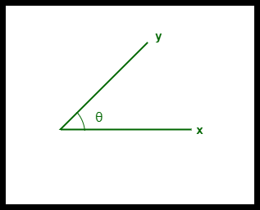
Cosine Similarity
Cosine similarity is a metric, helpful in determining, how similar the data objects are irrespective of their size. We can measure the similarity between two sentences using Cosine Similarity.
Cosine similarity between two vectors – ‘x’ and ‘y’
CS(x, y) = x . y / ||x|| ||y||
x . y = product (dot) of the vectors ‘x’ and ‘y’.
||x|| and ||y|| = length (magnitude) of the two vectors ‘x’ and ‘y’.
Cosine Distance= 1 - CS(x, y)

Slide 17
Cosine Similarity Example
 | x | y | xy | x^2 | y^2
 | 1 | 1 | 1 | 1 | 1
 | 1 | 1 | 1 | 1 | 1
 | 0 | 1 | 0 | 0 | 1
 | 1 | 0 | 0 | 1 | 0
 | 0 | 0 | 0 | 0 | 0
 | 1 | 1 | 1 | 1 | 1
∑ | 4 | 4 | 3 | 4 | 4
x = (1, 1, 0, 1, 0, 1)
y = (1, 1, 1, 0, 0, 1)
Cosine Similarity(x, y) = Σx*y / (√Σx^2 * √Σy^2)
=3/(√4+√4)
= 0.75
Cosine Distance = 1 - CS(x, y) = 1 - 0.75 = 0.25

Slide 18
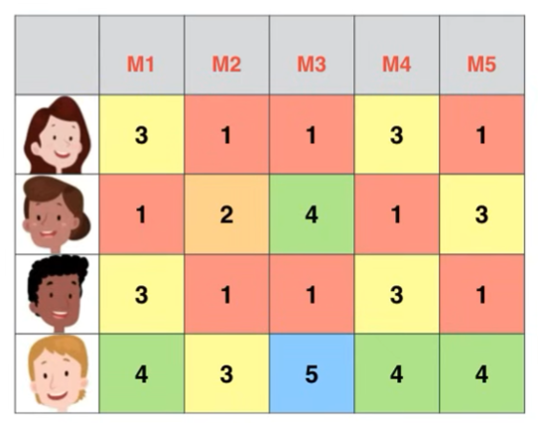
Matrix Factorization for Recommendation
Matrix factorization for recommendation is a technique that decomposes a user-item interaction matrix into lower-dimensional matrices to capture latent factors, enabling personalized and efficient recommendations.
latent factors could include user interests, item genres, user-item interactions, or temporal patterns.

Slide 19
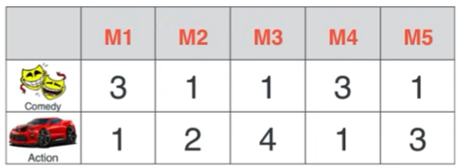
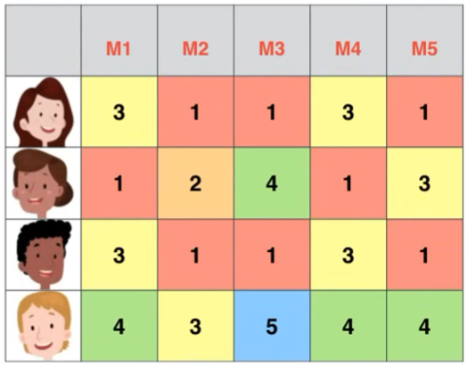
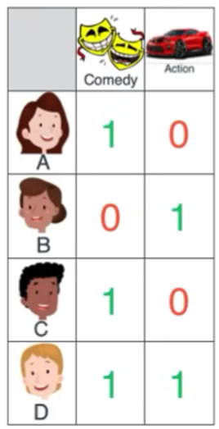
Data After Matrix Factorization
Matrix M
Matrix K
Calculation of one value
K[1,1]= 3*1+1*0= 3
Matrix K
K is Original Matrix, U is user matrix, M is movie matrix

Slide 20


Steps of Matrix Factorization Using Gradient Descent
K is Original Matrix, U is user matrix, M is movie matrix
Let r is rating defined for user u and item i, p is row of M for a user and q is the column of transpose(U) for a specific item i. So equation will become:

Slide 21
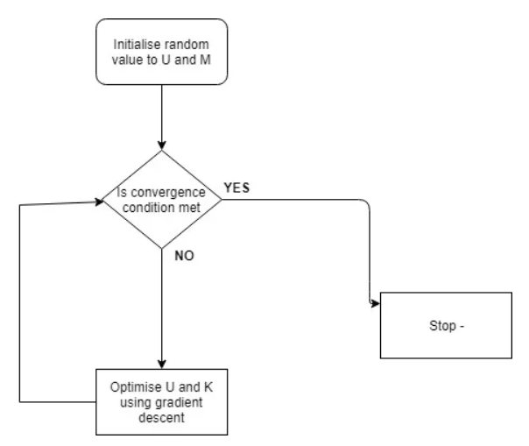
Here our task is to find matrix M and U
One way is to initialize random value to M and U and compare it with original Matrix K if value are close to K than stop the procedure otherwise minimize the value of U and M until they are close to K .
The process of these type of optimization is called gradient descent
Gradient Descent Flow Chart

Slide 22





Minimize the mean square error function which can be represented as :
Y : Actual Rating
Y~ : Predicted Rating
As our main task is to minimize the error i.e. we have to find in which direction we have to go for that we have to differentiate it, hence new equation will become
Hence the updated value for p and u will be now become:
Where alpha is learning rate generally its value is very small as higher alpha can overshoot the minimum value.

Slide 23
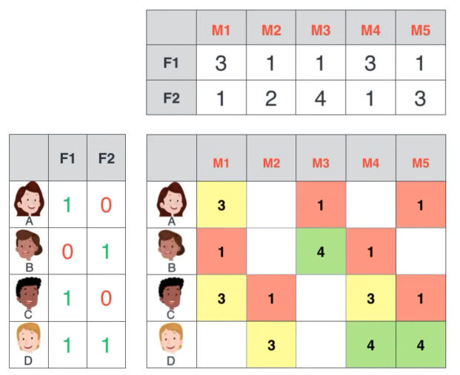
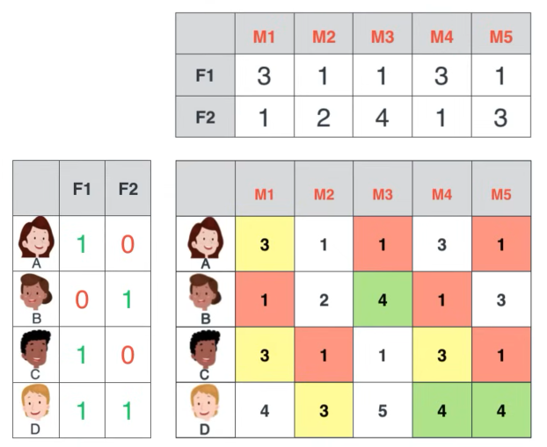
Predicting Rating Using Matrix Factorization

Slide 24
Thank you

